Slide 1
Title iii staff code of ethics
Employee training module April (updated 10-5-2016)

Slide 3
ASCOG code of ethics
ASCOG Sample Code of Ethics Agreement for all Title III Staff
The Code of Ethics Agreement must be signed by all employees, volunteers and contractors.
• No abuse, neglect, or exploitation of participants;
• No use of participant’s vehicle;
• No use of participant’s personal possessions not required for service delivery;
• No consumption of participant’s food or drink;
• No use of the participant’s telephone for personal calls0;
• No discussion of the employee’s or others’ personal problems, religious, or political beliefs with the participant;
• No acceptance of gifts or tips from the participant

Slide 4
Ascog code of ethics continued
• No friends or relatives brought to the participant’s home;
• No smoking in the participant’s home;
• No solicitation or borrowing of money or goods from the participant;
• No breech of the participant’s privacy or confidentiality of records;
• No purchase of any item from the participant;
• No assumption of control of the financial and/or personal affairs of the participant;
• No removal of anything from the participant’s home.
I have read the Code of Ethics Agreement and I agree to abide by it.
__________________________________________ _________________
_ ASCOG Title III Employee, Volunteer or Contractor Date
(Circle your employment status)

Slide 5
You must print and sign this Code of Ethics
http://www.ascog.org/wp-content/uploads/2015/08/ASCOG-Sample-Code-of-Ethics-Agreement-for-all-Title-III-Staff-3Feb2016.pdf

Slide 6
Avoid anything that’s compromising
Avoid all decisions that are compromising to your business and personal ethics.
Avoid all decisions where you must “cheat the system” or “cut corners”.
Always take the high road! Always do the right thing!

Slide 8
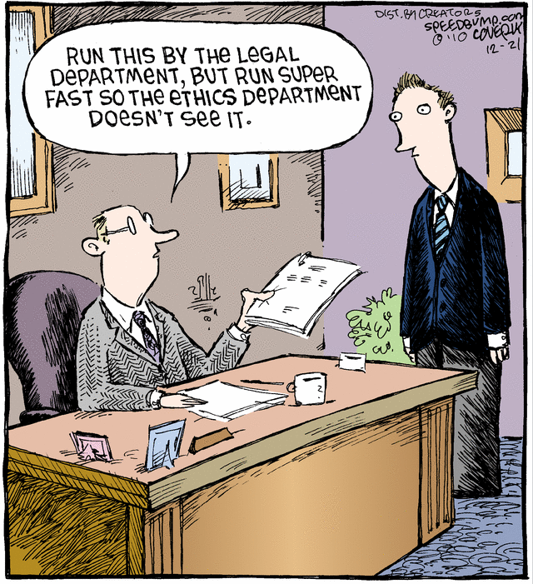

Slide 11
Sources
http://www.ascog.org/wp-content/uploads/2015/08/ASCOG-Sample-Code-of-Ethics-Agreement-for-all-Title-III-Staff-3Feb2016.pdf

