Slide 1
Aging Network
Training Module for August (updated 10-5-2016)

Slide 2
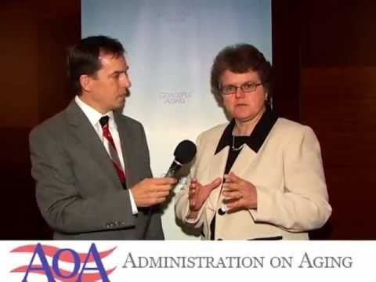
Aging Network Video (Double click to play video)

Slide 3
The Aging Network. To meet the diverse needs of the growing numbers of older persons in the United States, the Older Americans Act of 1965 (OAA), as amended, created the primary vehicle for organizing, coordinating and providing community-based services and opportunities for older Americans and their families

Slide 4
National Aging Network
The Administration on Aging (AoA) awards funds for nutrition and supportive home and community-based services to the 56 State Units on Aging (SUAs), 629 Area Agencies on Aging, 244 Tribal organizations, and 2 Native Hawaiian organizations. In addition, funds are awarded for disease prevention/health promotion services, elder rights programs (long-term care ombudsman program, legal services, and elder abuse prevention efforts), the National Family Caregiver Support Program (NFCSP) and the Native American Caregiver Support Program (NACSP).

Slide 5
OAA funding for programs is allocated to each SUA based primarily on the number of persons 60 years of age and over (70 years of age and older for the NFCSP) in the state. Most states are divided into planning and service areas (PSAs), so that programs can be tailored to meet the specific needs of older persons residing in those areas. The SUA grants funds to the Area Agency on Aging (AAA) designated for each PSA. The AAA determines the needs of older persons in the PSA and works to address those needs through the funding of local services and through advocacy. The AoA grants funds directly to Federally Recognized Tribal Organizations based on the number of Tribal elders who are 60 years of age and older. (See funding allocations to States and Tribal Organizations.

Slide 6
Poverty Guidelines From AoA
(Source: Federal Register, Volume 80, Number 14, January 22 2015, pp. 3236-3237)
Persons in Family or Household | 48 Contiguous States and DC | Alaska | Hawaii
1 | $11,770 | $14,720 | $13,550
2 | 15,930 | 19,920 | 18,330
3 | 20,090 | 25,120 | 23,110
4 | 24,250 | 30,320 | 27,890
5 | 28,410 | 35,520 | 32,670
6 | 32,570 | 40,720 | 37,450
7 | 36,730 | 45,920 | 42,230
8 | 40,890 | 51,120 | 47,010
For each additional person, add | 4,160 | 5,200 | 4,780

Slide 7

Oklahoma Association of Areas on Aging

Slide 8
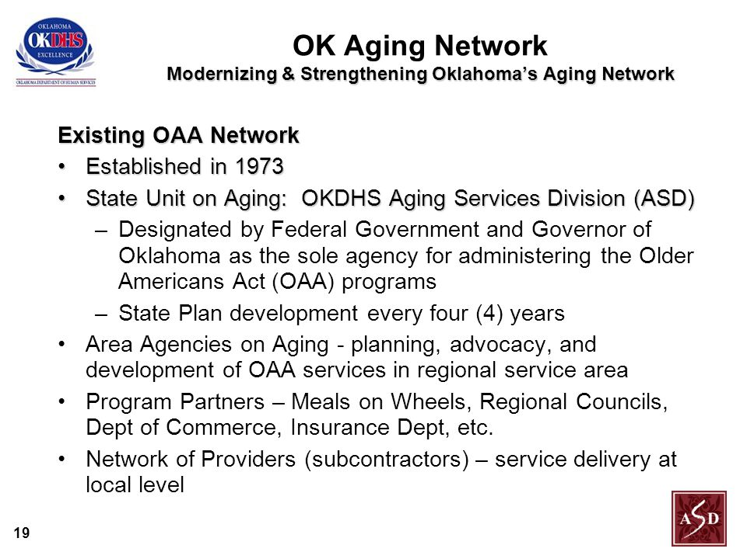

Slide 9
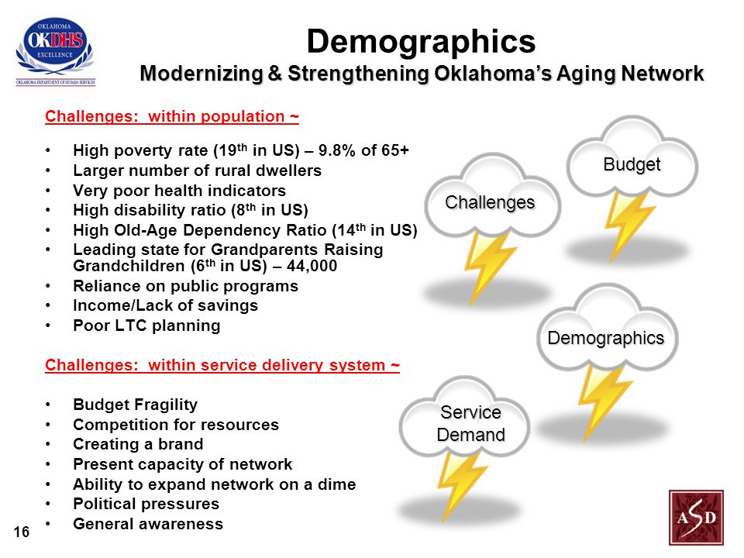

Slide 10
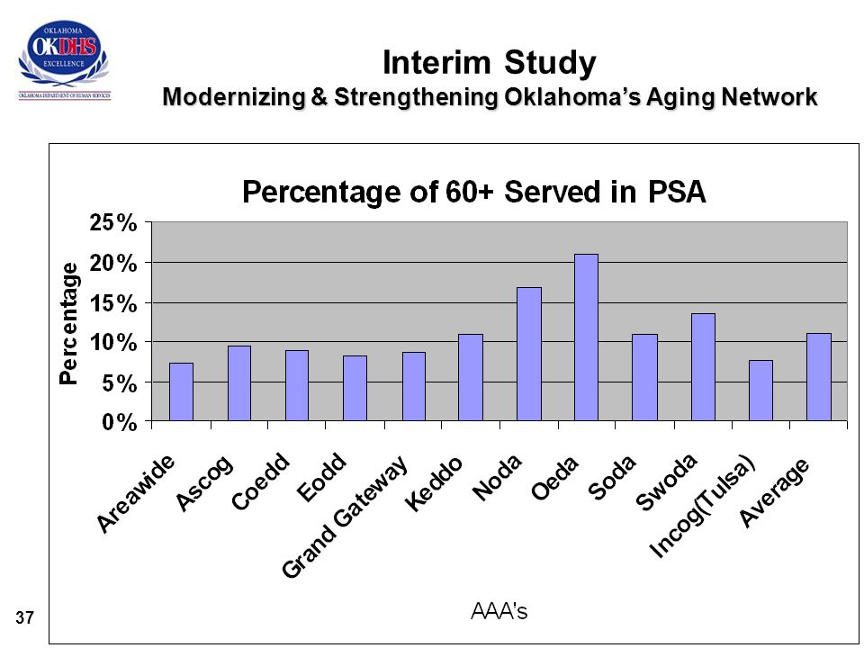

Slide 11
OK Aging Network
“ …… A unifying force at the state level through which the broad policy objectives of the Older Americans Act ultimately come to pass. An agency designated by the Governor as the focal point on all matters related to the needs of older adults.”

Slide 12


Slide 13
Resources
http://www.aoa.gov/AoA_programs/OAA/Aging_Network/Index.aspx
http://www.aoa.gov/AoA_programs/OAA/Aging_Network/Tools.aspx
http://www.aoa.gov/AoA_programs/OAA/Aging_Network/poverty_guidelines/Poverty_Guidelines.aspx
https://youtu.be/T6pSACyFV5Q
http://www.okdhs.org/
www.eldercare.gov

