Slide 1
Aging in
America
We Can Do Better

Slide 2
Why the Time for Reauthorizing and Revitalizing the
Older Americans Act is Now

Slide 3
^{Funding for Seniors}
^{Not Keeping Pace}
From 1980 to 2010
60%
Population
Increase
Adults 65+
59%
Funding
Decrease
AoA Funding

Slide 4


^{Funding for Seniors}
^{Not Keeping Pace}
^{Current Funding Levels Unable}
^{to Meet Increased Need}
$9.24
Per
Adults 65+
$3.85
Per
Adults 65+
1980
2010

Slide 5
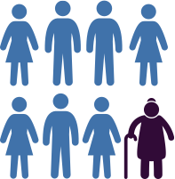

^{Funding for Seniors}
^{Not Keeping Pace}
Percent of Seniors Continues to Grow
2010
2030
One in Eight
One in Five
Adults 65+
Adults 65+

Slide 6

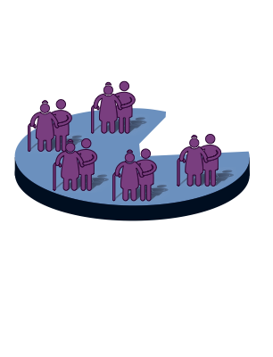
^{Aging services unable}
^{to meet demand}
57
Million
Adults 60+
11
Million
Served
ONLY

Slide 7


^{Aging services unable}
^{to meet demand}
^{If these trends continue…} millions will be eligible, few will be served.
1980 2010 2030
1980 2010 2030
36 57 92
236 155 ???
Millions of Seniors
Millions of Dollars

Slide 8

^{Aging in place is}
^{Cost Effective}
Annual Facility Care Cost
$42,600
Private pay
Assisted
living
$53,593
Medicaid
Financed
Nursing
Facility
$81,030
Private pay
Nursing Facility

Slide 9

^{Aging in place is}
^{Cost Effective}
Annual Facility Care Cost
$18,200-$20,800
Homemaker & Adult Care Services
$24,675
Home & Community
Based Medicaid Services

Slide 10

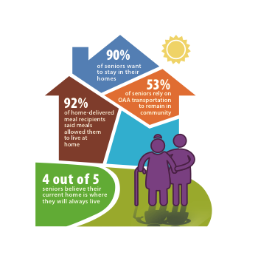
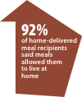






Older Americans Act Services
^{Help Seniors stay at home}

Slide 11
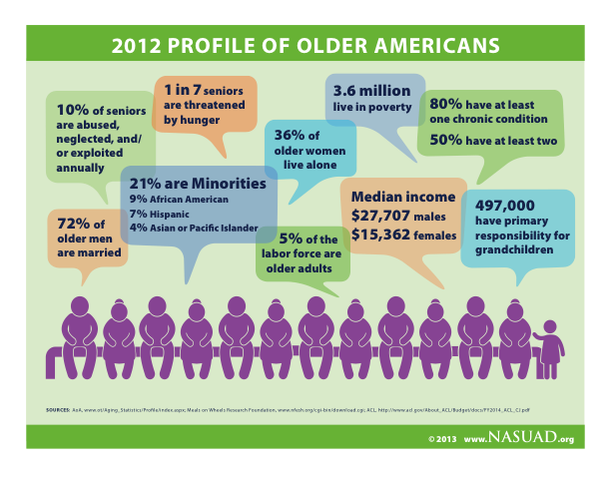
2012 Profile of older americans

Slide 12
Web: http://www.nasuad.org/newsroom/archive/2013/aging_in_america_we_can_do_better.html

