Slide 1
Transportation Grant Applications for SFY17
Only one application was received in response to the second RFP. That was from Community Action Development Corporation (CADC) in Frederick

Slide 2
CADC Transportation Application $39,678.00
Coverage area by county:
  Caddo: None (Cyril does have a transportation service through the Sr. Ctr.)
  Comanche: Geronimo
  Cotton: Temple and Walters
  Grady: Chickasha (Washita Valley subcontract)
  Jefferson: Ryan, Ringling
  McClain: Blanchard, Purcell and Washington (Delta subcontract)
  Stephens: None (Will publish new RFP in July)
  Tillman: Frederick

Slide 3
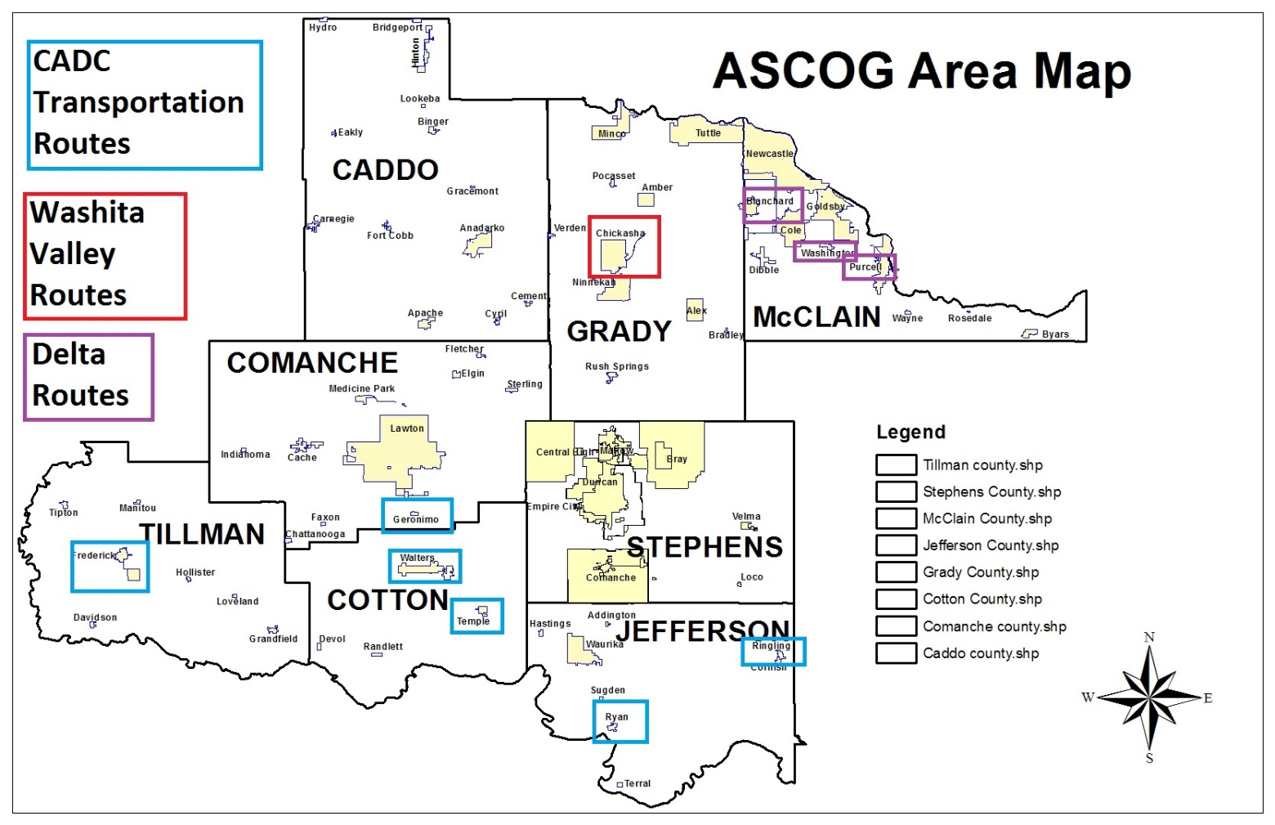

Slide 4
Scored by staff – Ken Jones
Project application determined to be complete.
Overall score of 166 out of a possible 200 points.
Presented to advisory council for review and comment on June 14.
ASCOG Board has final approval and cannot delegate this authority according to Title III policy.

Slide 5
Transportation Unit – one-way trip
Unit cost - $7.59
Total funding - $39,678.00
Units goal – 5,228 trips
Unduplicated persons served – 78
The project will provide transportation services to persons 60 and older residing within the planning and services area. Transportation services will facilitate access to and from a congregate meal site. This service consists of a one-way trip as a measure of unit.

Slide 6
Transportation units by service area
Route | Persons Served | Service Units | In-home/on demand
Temple | 5 | 400 | Yes
Walters | 6 | 400 | Yes
Chickasha | 15 | 800 | Yes
Geronimo | 7 | 400 | Yes
Ringling | 5 | 400 | Yes
Ryan | 7 | 450 | Yes
Blanchard | 8 | 600 | Yes
Purcell | 10 | 800 | Yes
Washington | 7 | 600 | Yes
Frederick | 8 | 300 | Yes
Total | 78 | 5,228 | In-home/on demand

Slide 7
Project Director – Brent Morey
Currently serves as the executive director of CADC since 1986
Started as Transportation Director in 1984
Transportation program is now second largest in the State of Oklahoma
Started at CADC in 1980 as Program Planner and Grant Writer
Masters of Human Relations, OU – 2009
Masters of Public Administration, OU – 2004
Served on multiple state-wide boards in leadership positions and received multiple accolades

Slide 8
Collaborative Effort
CADC is subcontracting with:
  Washita Valley – Grady County
  Delta – McClain County
  Name of CADC transportation program is Red River Transportation

Slide 9
Capacity of Transportation Project
CADC (and subcontractors) will use existing vehicles in communities it already serves
Trips are dispatched out of Frederick and Ryan
Fleet of 102 vehicles
Transportation supervisors in Frederick and Ryan for day-to-day operations
Full time maintenance coordinator and maintenance center in Frederick
Insurance, vehicle repair and maintenance, audit costs are all absorbed through the Agency Federal Transportation Grant

Slide 10
Budget for Transportation Grant
Drivers’ salaries - $25,000 (63%)
  Eight drivers working two hours per day at $9.07/hour
Fringe - $6,250 (15.75%)
Fuel - $6,428 (16.20%)
Administration - $2,000 (5.04%)
  Portion of audit - $500
  Supplies - $500
  Drug tests - $500
  Postage $500
Total grant $39,678.00

