Slide 1
ASCOG AAA Budget Cuts and Site Closures

Slide 2
Funding losses for SFY17
ADvantage meals - $120,000 to $150,000
DOC personnel - $26,076
Anticipated budget cut from DHS - $100,000 to $150,000 (not official numbers)
Total estimated loss for SFY17 - $326,076

Slide 3
Site closures for SFY 17 already confirmed
Pleasant Valley (Lawton – Comanche County) – no applicant
Hinton (Caddo County) – voluntarily going independent
Rush Springs (Grady County) - voluntarily going independent

Slide 4
Site closures since SFY10
Caddo County – 2 (Hinton and Apache)
Comanche County – 1 (Pleasant Valley – Lawton)
Cotton County – 1 (Randlett)
Grady County – 2 (Rush Springs and Verdon, only one site left)*
Jefferson County – 1 (Waurika)
McClain County – 0
Stephens County – 0
Tillman County – 0 (Only one site – Frederick)*
* - We are required to maintain at least one meal site per county.

Slide 5
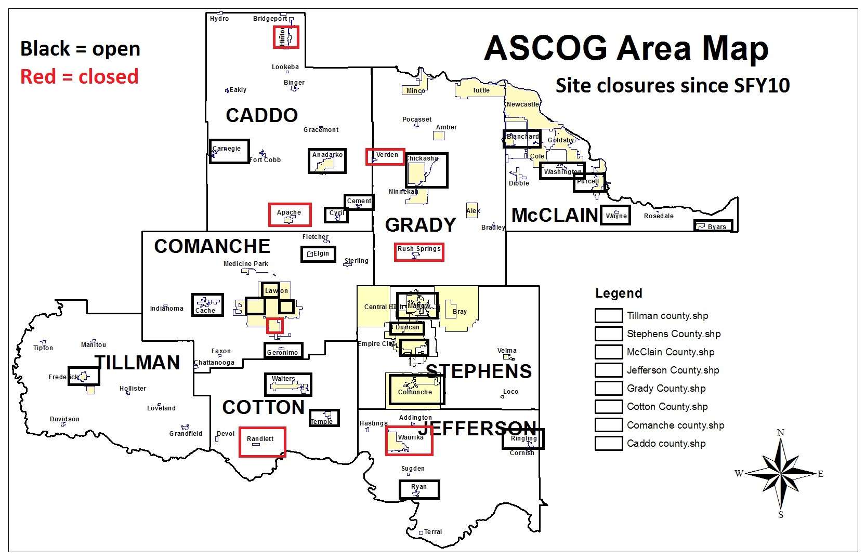

Slide 6
Funding Formula for Title III Nutrition is:
50% based on percentage of senior population 60+
25% based on 60+ population at or below poverty level
25% based on 60+ population of minority race
ASCOG must maintain minimum of $914,127 funding going to rural counties. Our rural counties include Caddo, Cotton, Grady, Jefferson, Stephens and Tillman Counties. Urban counties are Comanche County and McClain County.
Nutrition Services Incentive Program (NSIP) funding is base on meals served in last confirmed federal fiscal year.

Slide 8
Funding needed to maintain sites
County | Need | SFY16 Funding Formula
Caddo County | $ 204,591.26 | $ 316,667.27
Comanche County | $ 378,380.88 | $ 340,835.02
Cotton County | $ 125,799.26 | $ 76,258.81
Grady County | $ 98,354.98 | $ 242,170.02
Jefferson County | $ 124,056.88 | $ 62,155.98
McClain County | $ 259,035.37 | $ 91,274.28
Stephens County | $ 316,270.77 | $ 264,853.27
Tillman County | $ 96,648.46 | $ 102,362.36
Total Need | $ 1,603,137.86 | $ 1,496,577.00

Slide 9
Current Shortfall based on SFY16 numbers – ($106,560.86)
Caddo County - $112,076.01 surplus
Comanche County – ($37,545.86) shortfall
Cotton County – ($49,540.45) shortfall
Grady County – $143,815.04 surplus
Jefferson County – ($61,900.90) shortfall
McClain County – ($167,761.09) shortfall
Stephens County – ($51,417.50) shortfall
Tillman County - $5,713.90 surplus
Total – ($106,560.86) shortfall

Slide 11
Shortfall based on estimated 10% cut – ($256,218.56)
Caddo County - $80,409.28 surplus
Comanche County – ($71,629.36) shortfall
Cotton County – ($57,166.33) shortfall
Grady County – $119,598.04 surplus
Jefferson County – ($68,116.50) shortfall
McClain County – ($176,888.52) shortfall
Stephens County – ($77,902.83) shortfall
Tillman County – ($4,522.34) shortfall
Total – ($256,218.56) shortfall

Slide 13
Considerations allowed by policy
Number of persons age 60 years of age and older
Number of older persons in greatest economic need
Number of older persons in greatest social need
Number of low income minorities
Need for and availability of priority services
Availability of local resources, including volunteers
Collocation of services/focal point development
State and Federal Mandates
Minimum funding for rural areas - $914,127
Sites must serve at least 25 meals per day/250 days per year

Slide 14
According to metrics, communities with least/most Title III funding
Least funding:
Byars - $1,468.91
Washington - $2,522.92
Wayne - $3,967.80
Cement - $7,834.06
Elgin - $8,182.00
Geronimo - $9,943.50
Cache - $12,627.35
Ryan - $13,959.79
Most funding:
Lawton - $485,776.21
Duncan - $252,953.31
Chickasha - $169,178.23
Anadarko - $99,228.83
Frederick - $83,239.12
Marlow - $58,944.25
Carnegie - $55,488.34

Slide 15
Ad hoc committee’s recommendations for site closures
Byars - $52,851.83 (McClain County) - urban
Geronimo - $34,739.97 (Comanche County) - urban
Blanchard - $52,457.12 (McClain County) - urban
Washington $51,713.78 (McClain County) - urban
Comanche $73,410.04 (Stephens County) – rural
Total savings - $264,172.74

Slide 16
Site closures by county after closure of five sites recommended
Caddo County – 2 (Hinton and Apache)
Comanche County – 2 (Pleasant Valley and Geronimo)
Cotton County – 1 (Randlett)
Grady County – 2 (Rush Springs and Verdon, only one site left)*
Jefferson County – 1 (Waurika)
McClain County – 3 (Byars, Blanchard and Washington)
Stephens County – 1 (Comanche)
Tillman County – 0 (Only one site – Frederick)*
* - We are required to maintain at least one meal site per county.

Slide 18
Funding needed after closures
County | Need | 2017 Funding Formula post cut
Caddo County | $ 204,591.26 | $ 285,000.54
Comanche County | $ 343,640.91 | $ 306,751.52
Cotton County | $ 125,799.26 | $ 68,632.93
Grady County | $ 98,354.98 | $ 217,953.02
Jefferson County | $ 124,056.88 | $ 55,940.38
McClain County | $ 103,012.64 | $ 82,146.85
Stephens County | $ 242,860.73 | $ 238,367.94
Tillman County | $ 96,648.46 | $ 92,126.12
Total Need | $ 1,338,965.12 | $ 1,346,919.30

Slide 19
Shortfall by County after closures of recommended sites
Caddo County - $80,409.28 surplus
Comanche County – ($36,889.39) shortfall
Cotton County – ($57,166.33) shortfall
Grady County – $119,598.04 surplus
Jefferson County – ($68,116.50) shortfall
McClain County – ($20,865.79) shortfall
Stephens County – ($4,492.79) shortfall
Tillman County – ($4,522.34) shortfall
Total – $7,954.18 surplus

Slide 21
Additional closures if needed
First, we would request a waiver of the 250 days per year requirement for sites in counties where there is a shortfall.
Also, we would close any site that drops below 25 meals per day in a county that has a shortfall.
Then:
Ryan - $55,077.94
Temple - $59,074.00
Elgin - $62,291.51

Slide 22
Community Expansion for Nutrition Assistance Grant from ODOC
SFY16 funding for independent senior centers was $189,038.00
SFY17 funding is expected to be $171,835.54 (9.1% cut). That is a loss of $17,202.46.
Due to Title III nutrition site closures we expect to have eight new CENA sites eligible for food.
In SFY16 – we funded 36 sites total with twelve (12) serving meals at least weekly with an award ceiling of $10,000 and no floor.
In SFY17 – we expect to fund 20 CENA centers with all 20 serving meals at least weekly with an award floor $5,000 and a ceiling of $10,000.

Slide 23
Expected SFY17 CENA Grant according to metrics from SFY16
Alex - $8,737.40
Apache - $9,708.22
Binger - $9,708.22
Blanchard - $8,154.91
Byars - $5,824.93
Comanche - $9,708.22
Dibble - $9,708.22
Ft. Cobb - $9,708.22
Geronimo - $5,242.44
Grandfield - $9,708.22
Hinton - $9,708.22
Minco - $9,708.22
Newcastle - $9,708.22
Ninnekah - $9,708.22
Rush Springs - $7,960.74
Tipton - $7,766.58
Tuttle - $9,708.22
Velma - $5,824.93
Washington - $5,824.92
Waurika - $9,708.22

Slide 24
CENA centers expected to lose all CENA funding (below $5K floor)
Anadarko
Borden Park (Chickasha)
Bradley
Bray
Cache
Center for Creative Living (Lawton)
Chattanooga
Cyril
Douglass
Duncan
Frederick
Hastings
Indiahoma
Marlow
Meers
Mount Scott
Purcell
Ryan
Temple
Walters
Wichita Mtn. Area Senior Ctr.
Negative impact on senior nutrition sites is approximately $28,000.

Slide 25
Other factors
Approximately 12 percent of our Title III funding is matched by local donations. Those donations are lost when you defund a site. That means with a 10 percent cut we will probably lose an additional $30,000 in lost donations to the Title III Nutrition program.
Most of our sites are supported through local communities. Many of those communities are dependent on revenue that is indirectly based on the oil industry. In about six months, when the severance packages go away for laid off oil industry personnel, the communities will lose some of their capacity to support these programs.

Slide 26
Other factors – continued
Approximately $600,000,000 of the state budget for SFY17 is from one time revenue sources which means we are already in a budget shortfall for SFY18.
Some of the revenue generating measures passed in the 2016 legislature will likely be challenged in the courts and could impact the SFY17 budget with a mid-year cut.
The oil industry is not out of the woods yet.
The unknown impact of the loss of institutional memory. For example, Mary Rogers (Byars) and Brenda Worley (Blanchard) are two of our most experienced site managers.

